Slide 1
Molecular Dynamics Solution 1KZY
Arya HajiTaheri

Slide 2
Overview
Why MD?
1KZY information
1KZY In Medicine
Methods to Simulate
Preparing solution
Protein Models
Computing and analysis
Alternate Test cases
Future Developments

Slide 3
Why MD?
A method for studying the physical movements of atoms and molecules.
Molecular dynamics (MD) simulation combines concepts from quantum and statistical mechanics
Molecular systems typically consist of a vast number of particles, it is impossible solve such complex systems analytically; MD simulation circumvents this problem by using numerical methods.
MD is used in variety of fields in the industry:
Produce optimal drugs to fight harmful microorganism
Slow down/stop cancer cells from growing.
Produce cost-effective/environmentally friendly resources

Slide 4
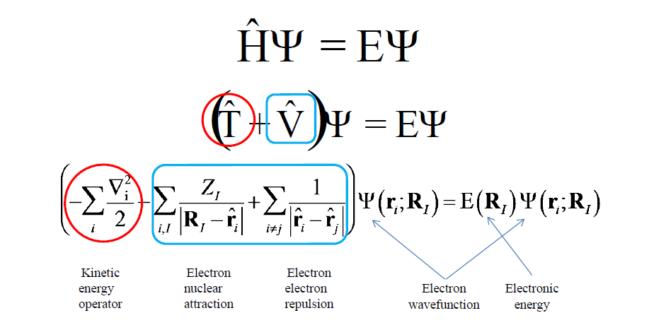
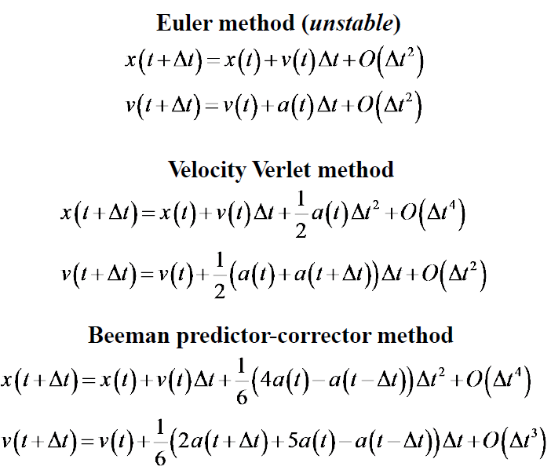
MD Mechanics
All ground-state quantum chemistry is based on the time-independent Schrödinger’s equation:
J. M. Haile (2001) Molecular Dynamics Simulation: Elementary Methods. ISBN 0-471-18439-X
In the case of 1KZY, the Verlet Integrator and Langevin Integrator was used:
Verlet, Loup (1967). "Computer "Experiments" on Classical Fluids. I. Thermodynamical Properties of Lennard−Jones Molecules". Physical Review. 159: 98–103. doi:10.1103/PhysRev.159.98.

Slide 5
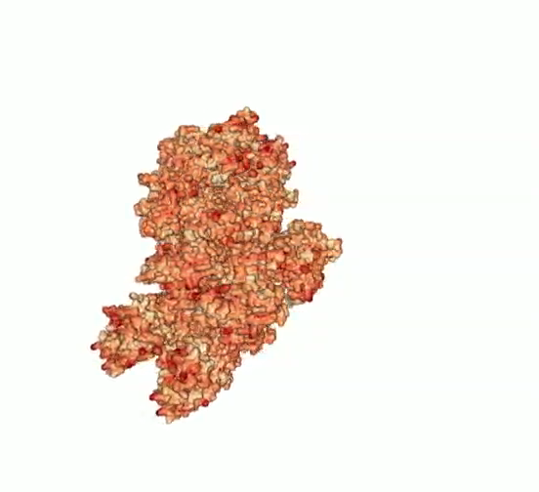
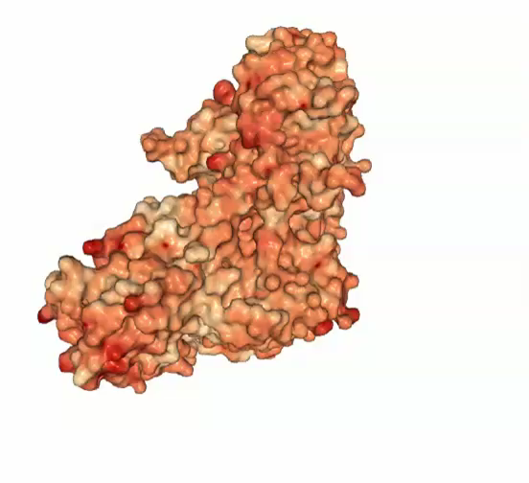
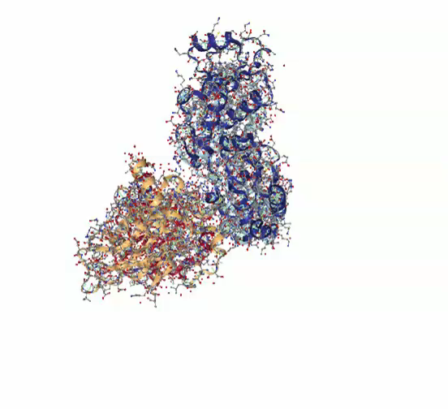
1KZY information
Proteins are large molecules consisting of one or more long chains of amino acid residues. Proteins perform a vast array of functions within organisms, including catalyzing metabolic reactions, DNA replication, and transporting molecules from one location to another and etc.
1KZY is composed of 4 amino acid chains (53BP1 + P53)
Unit protein protein cell protein structure

Slide 6
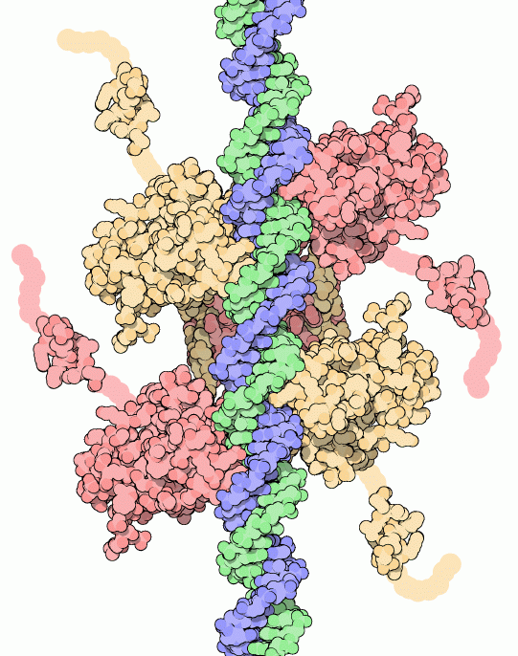
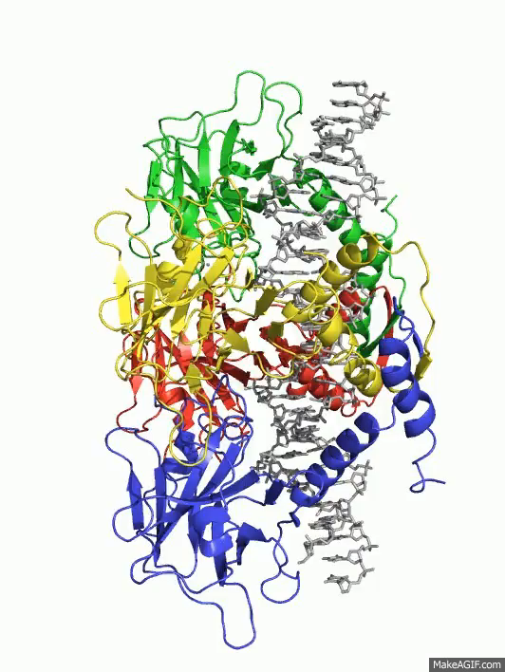
1KZY (53BP1 + P53) In Medicine
Mutations in this gene are associated with a variety of human cancers.
The TP53 gene is the most frequently mutated gene (>50%) in human cancer. TP53 gene encodes proteins that bind to DNA and regulate gene expression to prevent mutations of the genome.
Lane Group at the Institute of Molecular and Cell Biology (IMCB), Singapore. p53 Knowledgebase [Retrieved 2008-04-06].
This gene encodes a tumor suppressor protein containing transcriptional activation, DNA binding, and oligomerization domains.
The encoded protein responds to diverse cellular stresses to regulate expression of target genes, thereby inducing cell cycle arrest, apoptosis, senescence, DNA repair, or changes in metabolism.

Slide 7
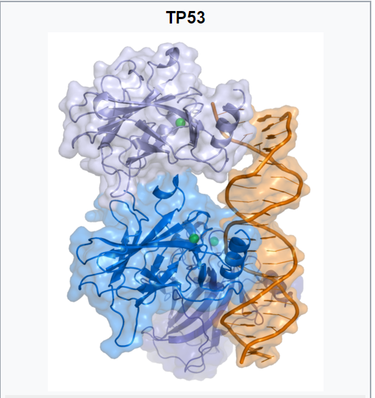
So how does MD come into play?
Increasing the amount of p53 may seem a solution for treatment of tumors or prevention of their spreading. This, however, is not a usable method of treatment, since it can cause premature aging.
With MD, we are able to simulate, predict, and eventually produce a protein that requires a low binding energy and has a low chance of mutation.
Molecular dynamics allows us to produce the finest chain of protein possible, which works well with the surrounding environment, and is more likely to prevent cancer.
David S. Goodsel l date=2002-07-01. RCSB Protein Data Bank. p53 Tumor Suppressor [Retrieved 2008-04-06].

Slide 8
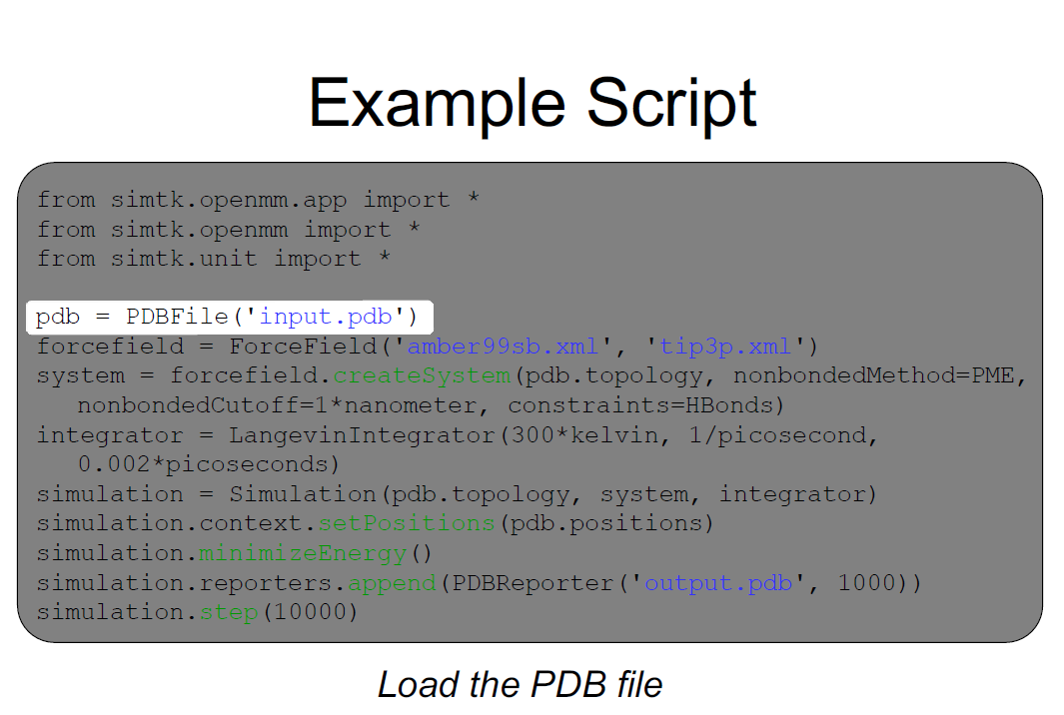
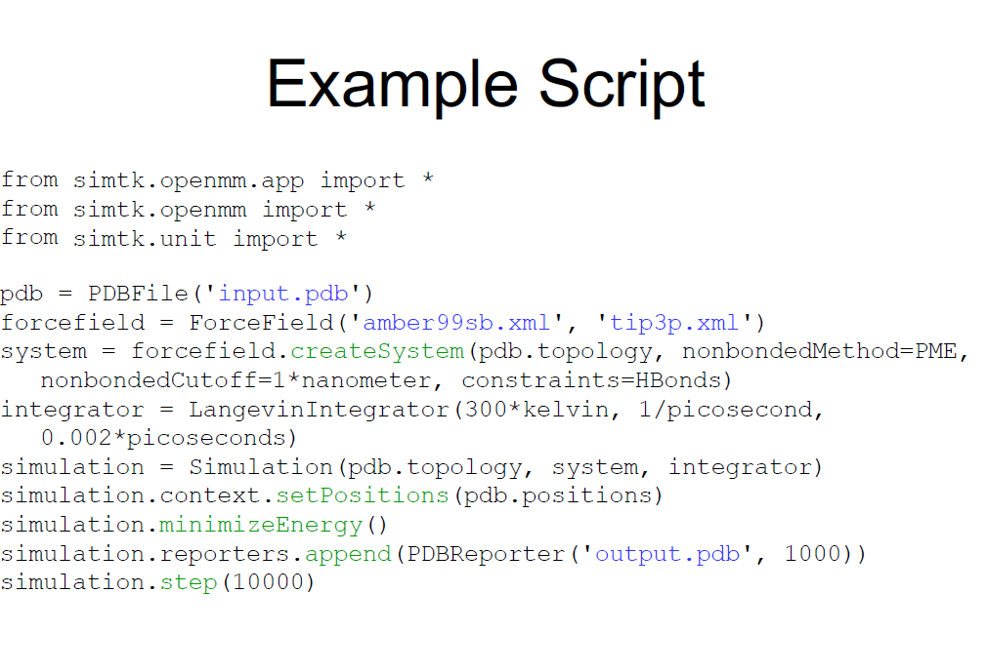
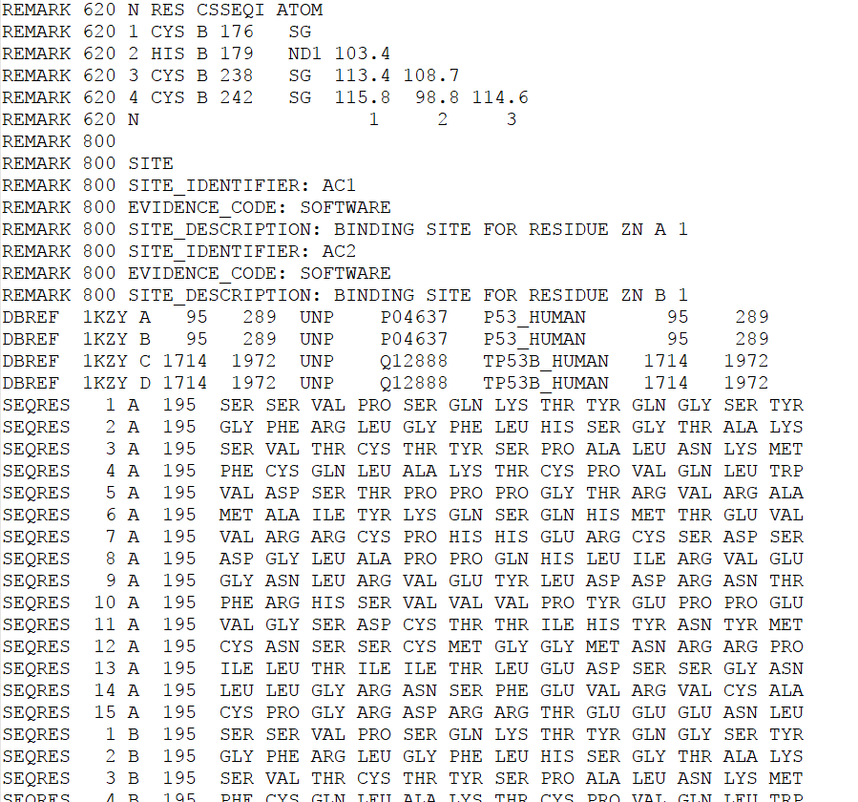
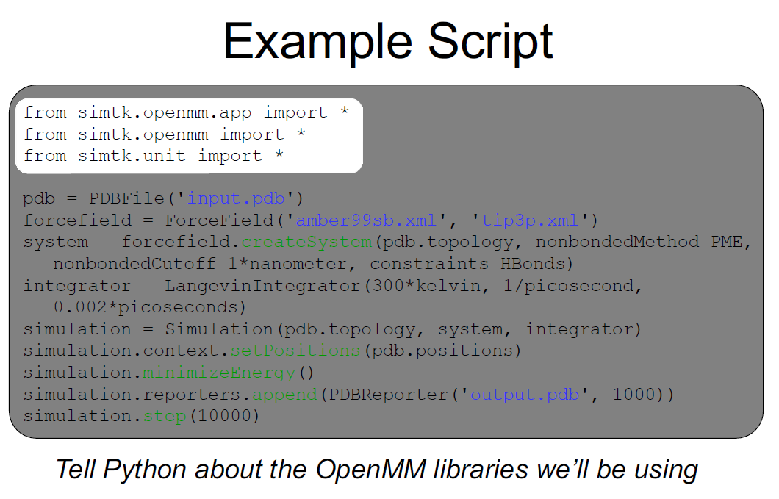
Methods to Compute and simulate

Slide 9
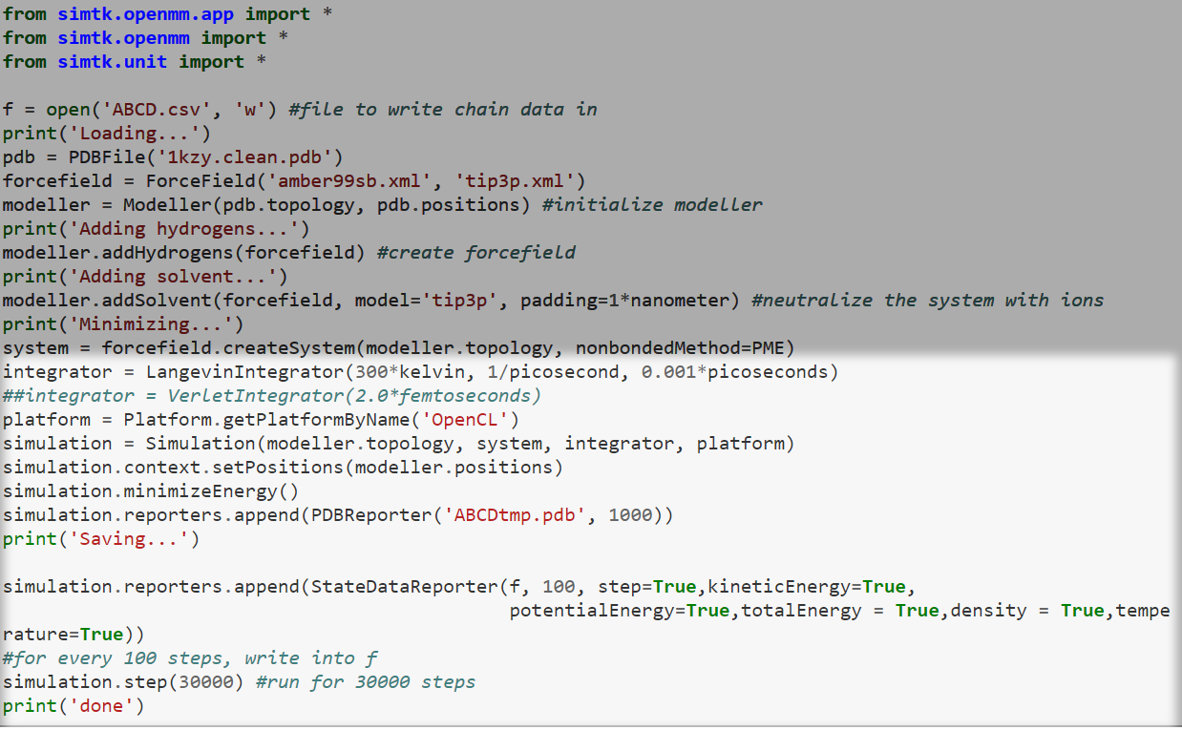
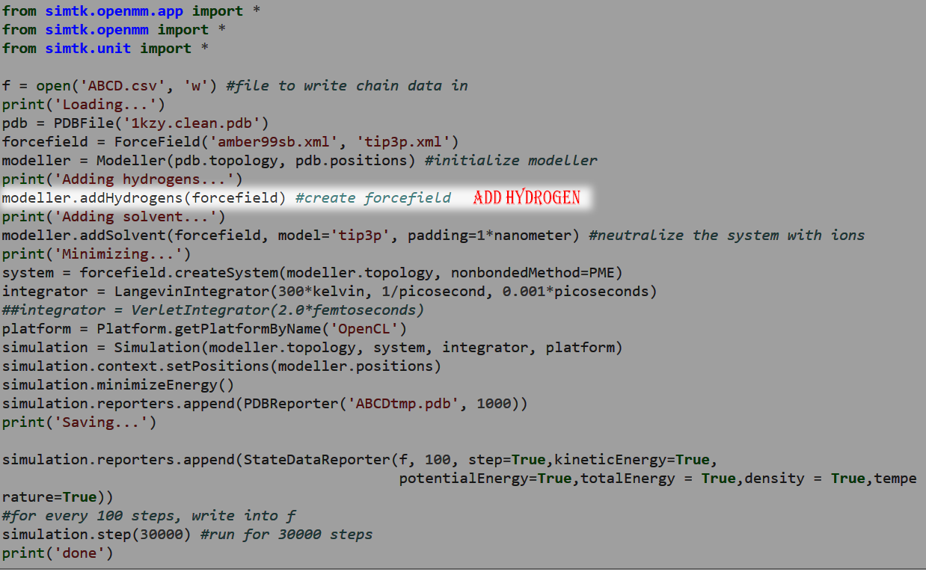
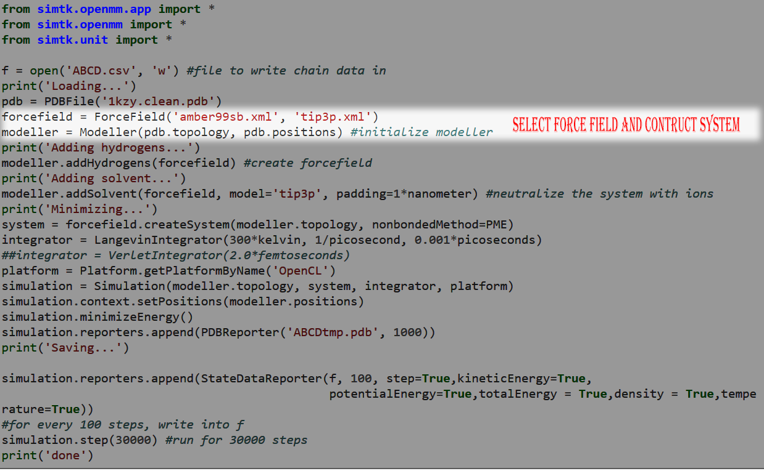
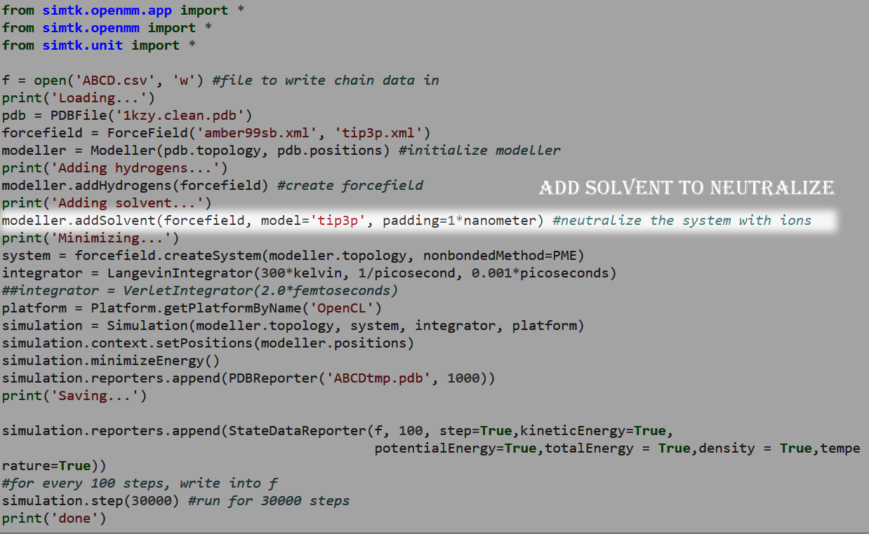
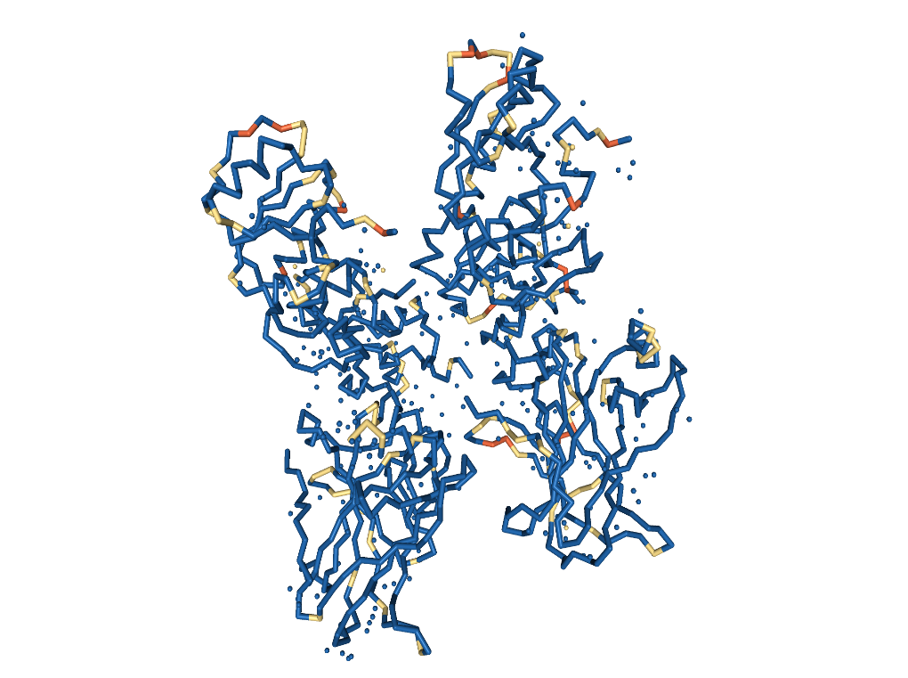
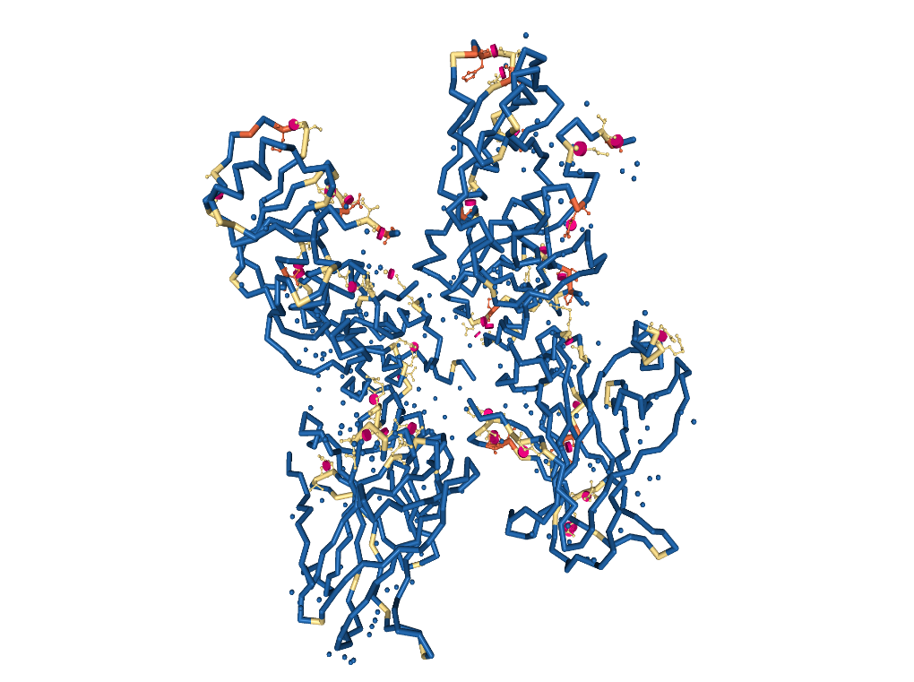
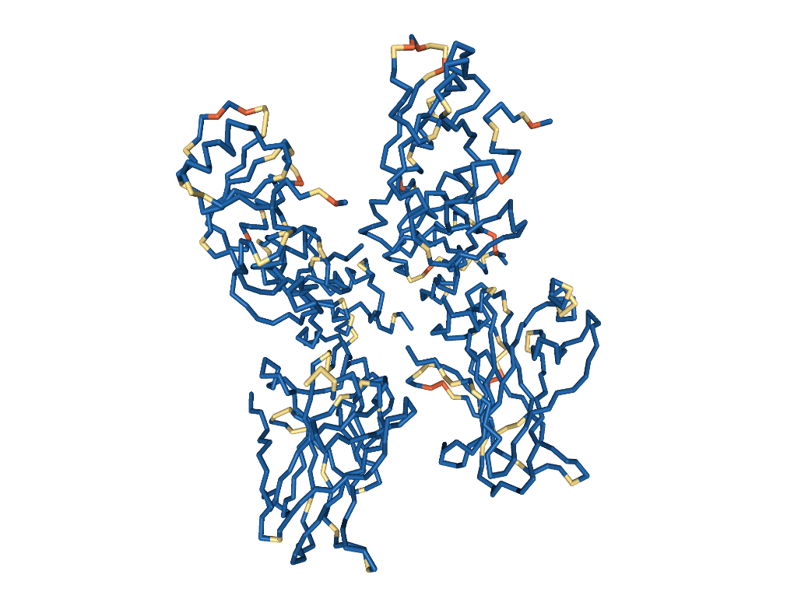
Simulation code

Slide 10
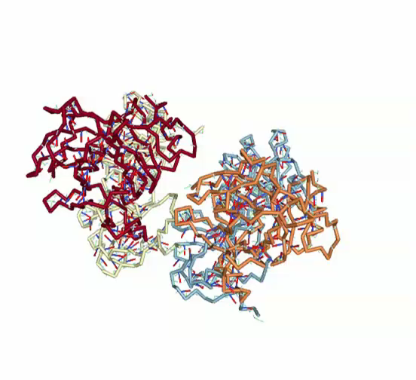

Slide 11
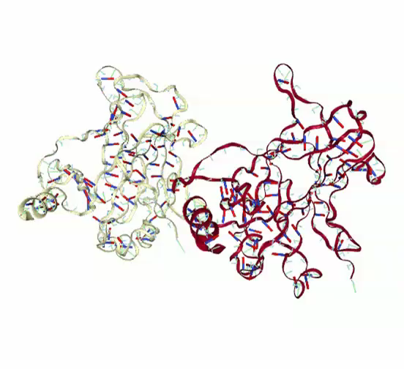
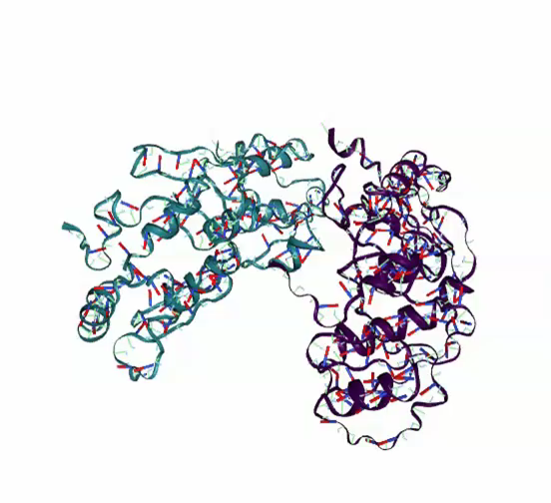
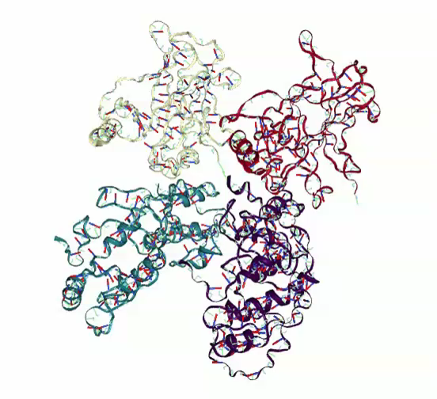
Separating the chains
After running the simulation on the full protein, the four chained protein was separated to chain AB (P53) Tumor antigen + chain CD (53BP1) Tumor Suppressor component. This was done to calculate the binding energy.
The same simulation was executed for each individual chain:
Chain AB: Chain CD: Chain ABCD:

Slide 12
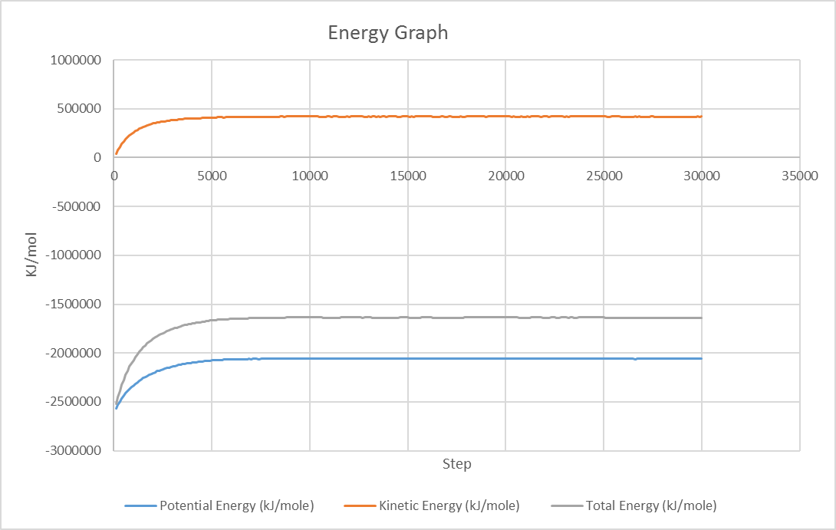
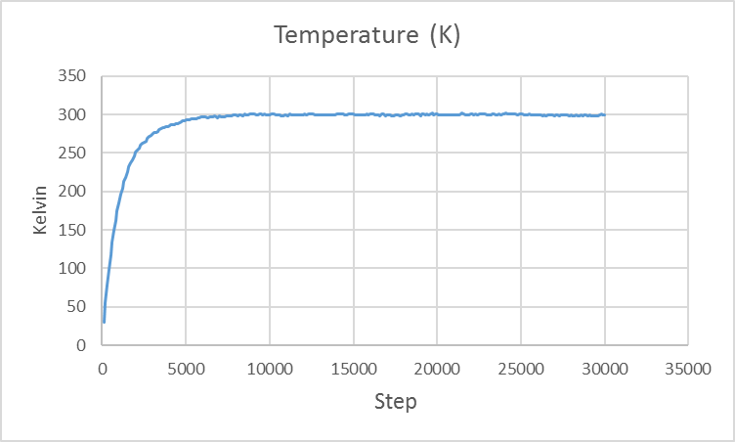
Results at 300 K for chain ABCD
The total energy of each chain group plus the parent protein was calculated at 300° Kelvin (room temperature ~ 26 °C) at every 100 step for 30000 time steps. As you can see, the solution releases heat to the environment and reaches equilibrium at the same time as the energy graph.

Slide 13
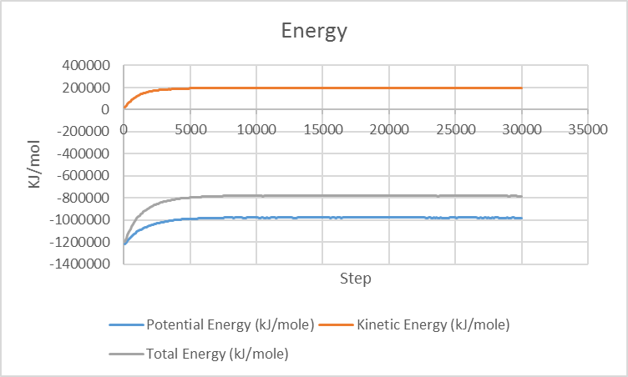
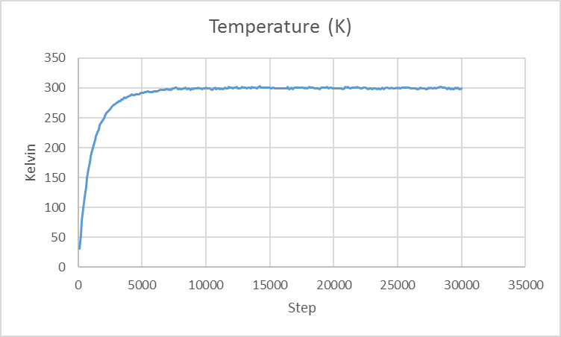
Results at 300 K for chain AB

Slide 14
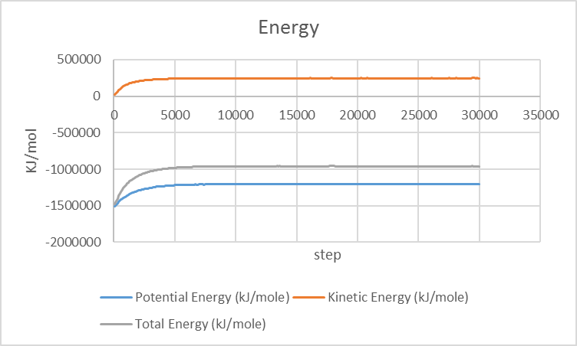
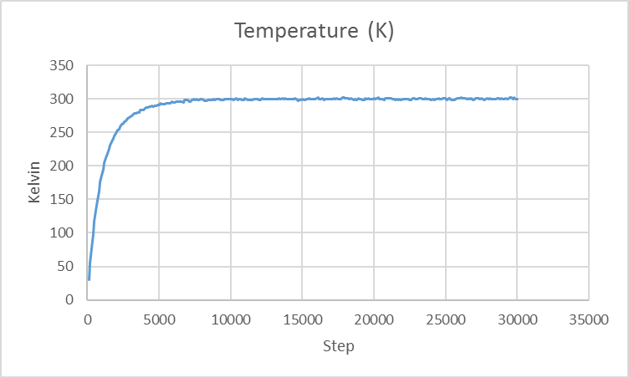
Results at 300 K for chain CD
They all seem to reach an equilibrium after 8000 steps.

Slide 15
What does all of this mean?
The total energy values from the previous graphs are collected to calculate the binding energy using the following:
BE =Energy for (P53) + Energy for (53PB1) - Energy for complex (53BP1 - P53)
The binding energy at 300 Kelvin is – 103038 KJ.
Binding energy is negative because if it was positive, or zero, then the atoms would separate and escape into space.
Think of it this way- The protons and neutrons in a nucleus are held together by the strong nuclear force, and have potential energy (and negligible kinetic energy). To just separate them, you will have to do positive work on them, such that their final energy is zero.
Lesser the Binding energy = The more useful the protein is.

Slide 16
Alternate Test cases (High Temperature)

Slide 17
Alternate Test cases (Low Temperature)

Slide 18
Alternate Test cases (High step size)

Slide 19
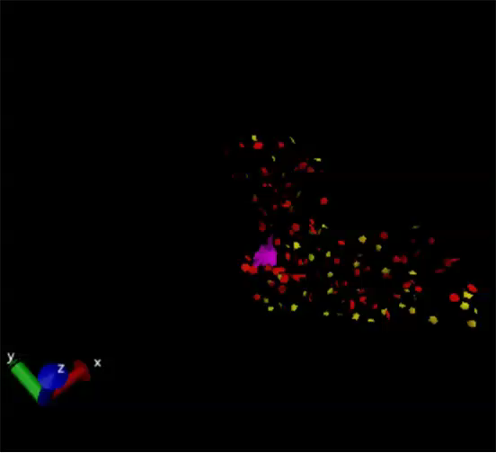

Slide 20
Future Developments
The simulations presented so far are still limited and can barely help us to produce an optimal protein chain.
What Can Be Done?
An obvious way to improve the study on tumor regulating genes is to increase the time scale, to truly see if the results are stable.
However, that is not enough. A popular method in MD is to build or use existing amino acids or protein chains and use it to bind to the tumor suppressor.
The new protein bind that has the most stable state and the lowest binding energy can be used in creating a new drug, and perhaps a possible solution in treating cancer and other genetic mutation.

